Slide 1
Board Update – Q2 & Q3 FY21 February 10, 2021
Emily Schapira, Executive Director
eschapira@philaenergy.org · P: 215-686-4483

Slide 2
Organizational Updates
Vice President, Strategy & Operations job description posted, outreach begun
New Org Structure aligned to Residential & Commercial programs rather than Solar & EE
Prepping to move MM to PGCC and replace with Director of Commercial Programs at PEA
Transition support from Lisa Shulock
New Development Director to build fiscal sustainability

Slide 3
FY21 Q2 + Q3 program activity overview
AFFORDABLE
OTHER INITIATIVES
PGCC incorporation paperwork filed (Green Bank)
Bright Solar Futures 10th graders in 2nd semester; 2nd PowerCorps cohort started in January.
New funding for GRIT
Solar Equity & Access Fee work ongoing with SEIA, REBA, others
Solar PPA COVID delay contracting resolved, moving forward
Streetlighting RFP will be released in this quarter
SSGP: 37 contracts signed, first project installed, funding for 41
BTL roadmap complete, fundraising ongoing, 1st pilot beginning in Q4.
90,000+ households enrolled in Water
Sewer Program, 5,000+ in new programs
October 30, 2019
Construction substantially complete on GESA-I Ph. 1 (3 schools), Construction has begun on GESA-I Ph. 2 (4 schools), scoping in progress for Ph. 3.
New RFP released for GESA-II Ph. 1 (3 schools), up to 20 schools to be covered under contract.
Curtis Institute project under construction
Adding cultural institutions to BlocMaps tool
55 projects in CPACE pipeline

Slide 5
4 Rounds, Largest in the U.S.
747
3.3 MW
$12+ MM
6,429
98
Total
53 (Market-Rate)
37 (LMI)
573
Ph 4

Slide 6
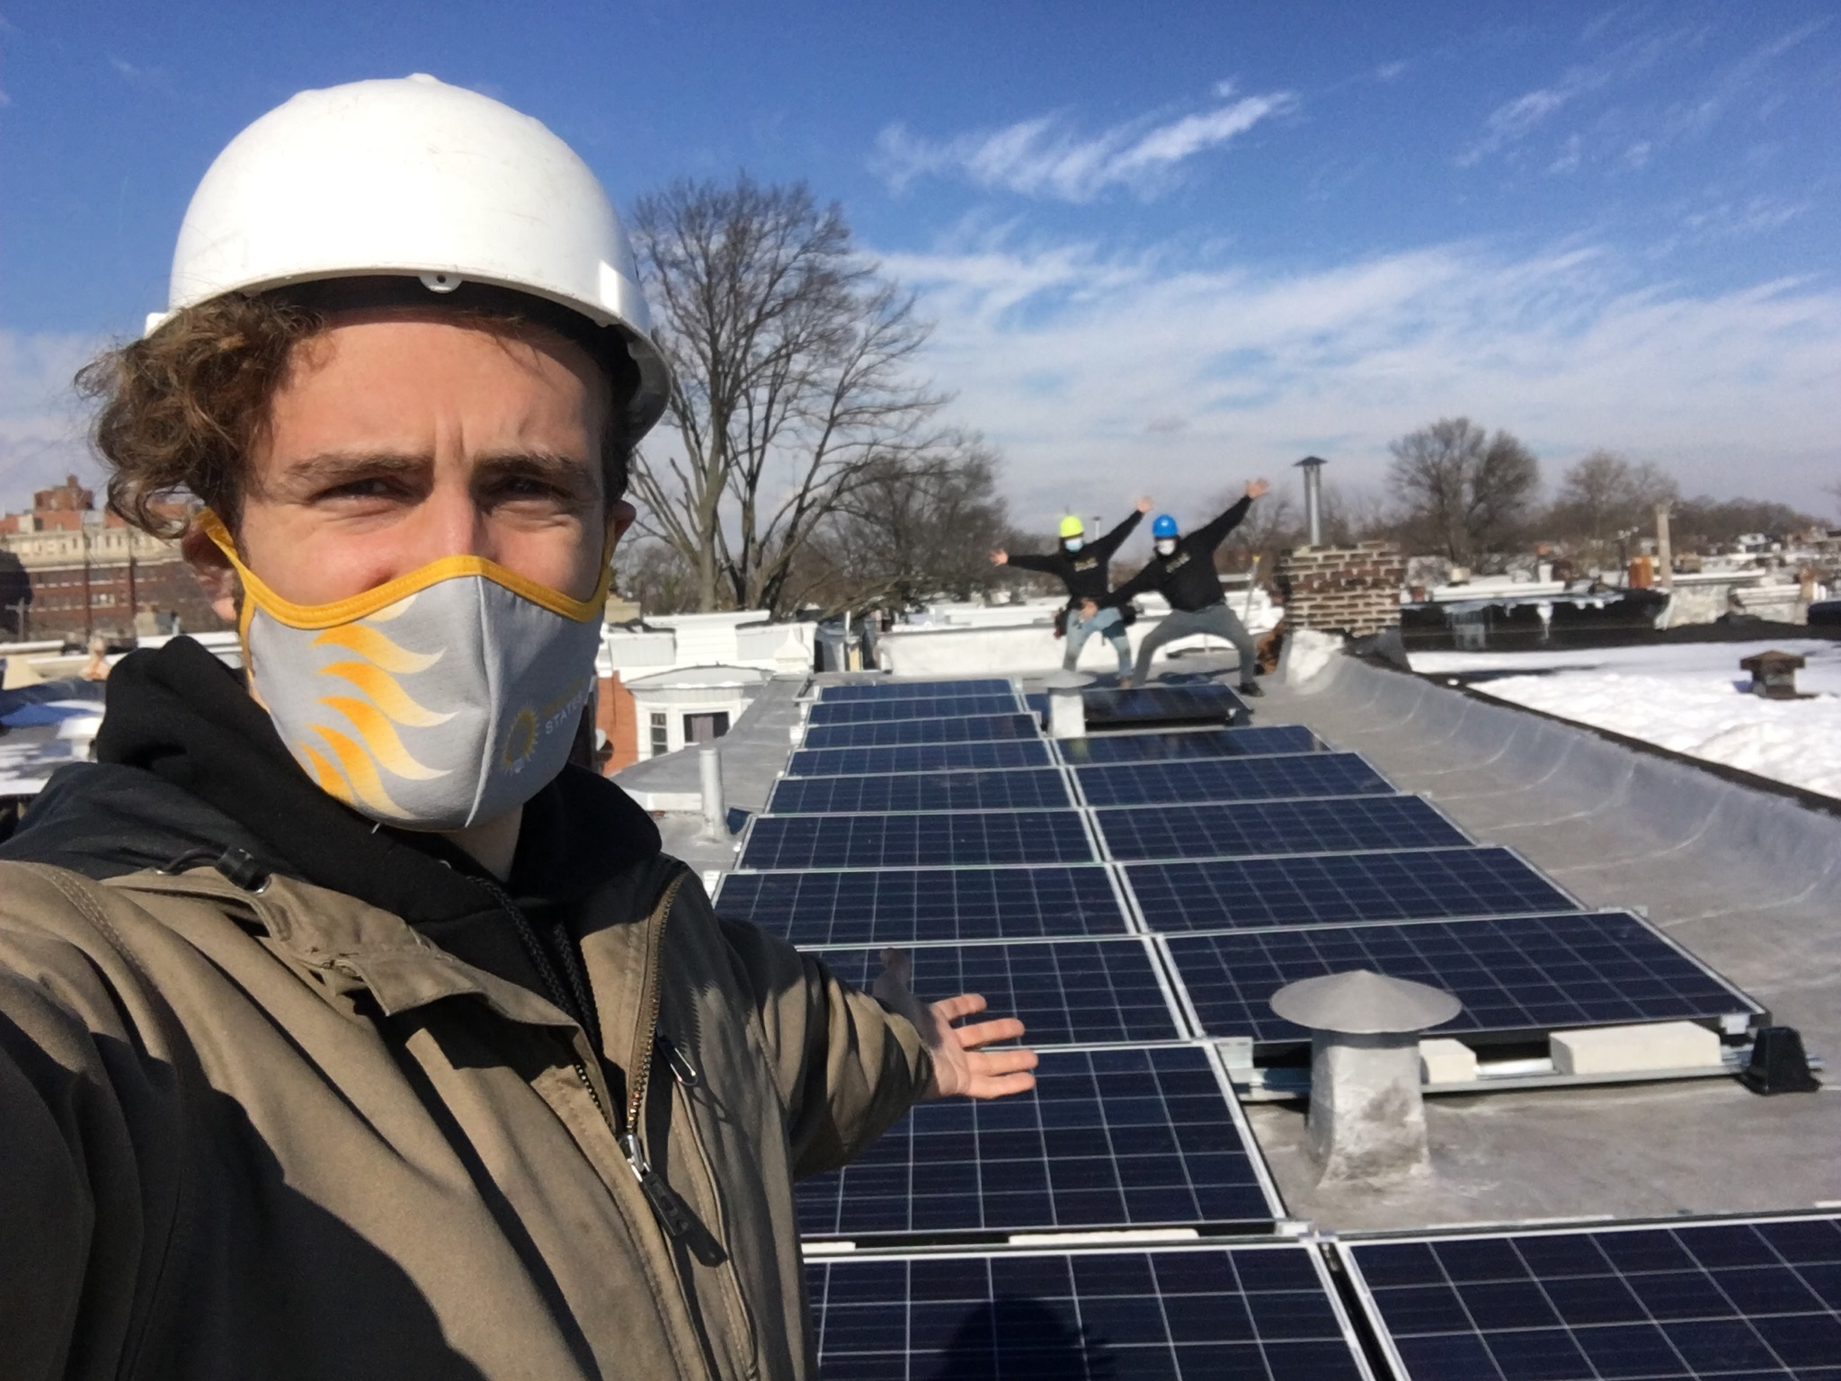
Solar Savings Grant Program
First installation complete!
37 contracts signed with 4 more approved, maxing out $220,000 in loan funds available. Waiting list of additional households ready to sign.
Includes households <80% AMI from 23 different zip codes.
Preparing media plan to announce completion of pilot.
First Solar Savings Grant Program installation
Credit: Solar States 2021
Notes:
First 5 contracts signed. Pipeline of 45 eligible households.

Slide 7
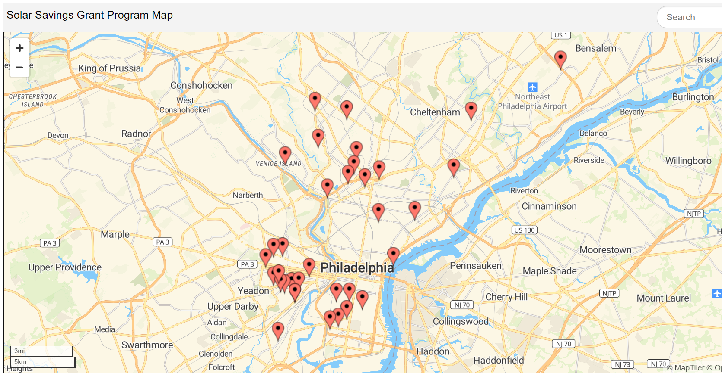

Slide 8
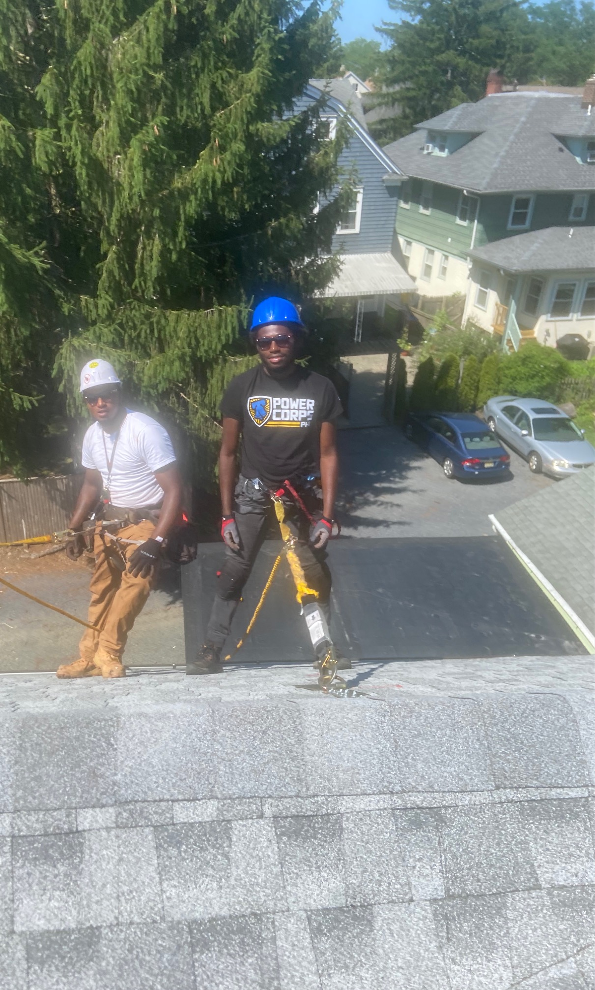
Bright Solar Futures
First High School CTE Solar Program in PA
Started in September 2020 with 10th graders at Frankford HS
Continuing virtually in line with SDP requirements
15 students enrolled, recruiting next class of 10th graders
Opportunity Youth (in partnership w. PowerCorpsPHL)
Parallel pathway for young adults not engaged in school or employment (age 18-30)
First cohort completed May 2020. Placed 11 of 12 graduates into full-time employment, despite COVID
Second cohort started January 2021
Hybrid model: weekly in-person labs, 5 students at a time at ECA
BSF 2020 graduate working for Solar States as installer
Notes:
(1 Gen3, 4 Solar States, 2 PWD, 4 other (Powercorps/Habitat for Humanity)).

Slide 9
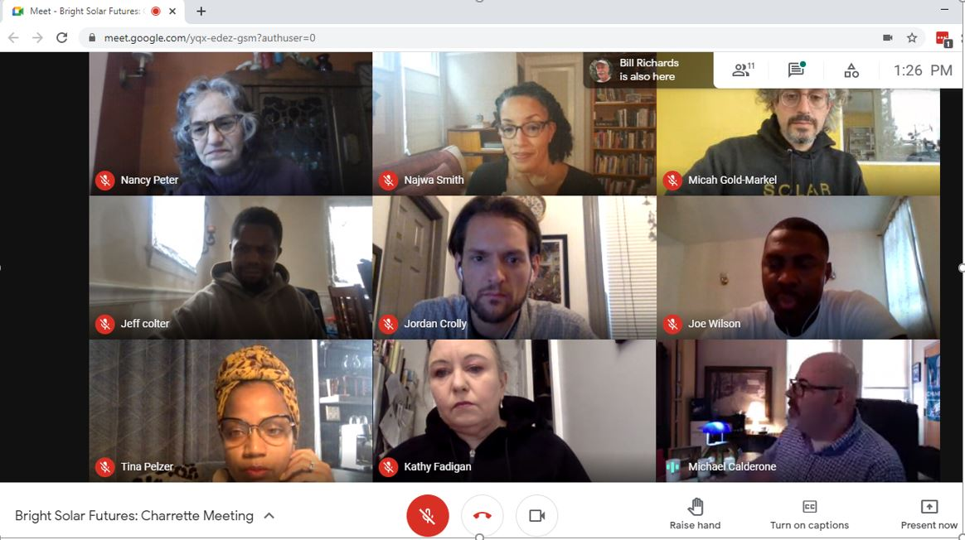

Slide 10
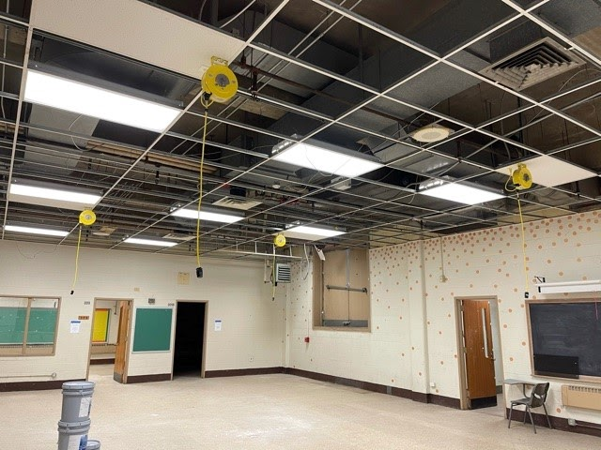
Frankford Solar Lab
Supported with $150k from PECO, $10k from NECA, $10k from Community Energy
In-kind equipment donations totaling $47k
$61k in equipment and supplies purchased by School District CTE Office
School District Facilities team completing minor repairs, painting, and ceiling tile replacement
Minor electrical work completed by Eagle Electric
Second phase of HVAC, window installation, and additional electrical work planned for summer
Cord reels will provide power to hand tools and training stations
Notes:
(1 Gen3, 4 Solar States, 2 PWD, 4 other (Powercorps/Habitat for Humanity)).

Slide 11
Green Retrofit Immersive Training (GRIT)
Supported by $250k grant from Phila Dept of Commerce
Aiming to enroll 17 trainees who are unemployed or returning from incarceration
Training: 11 weeks, hosted by ECA, earning 5 credentials
Internship: 6 weeks, hosted by Friends Rehabilitation Program in partnership with Provision Vocational Training Center, retrofitting single-family units for affordable housing
Designed as workforce development pairing for Built to Last, to ensure pipeline of talent for contractors that will experience rise in workload
Notes:
(1 Gen3, 4 Solar States, 2 PWD, 4 other (Powercorps/Habitat for Humanity)).

Slide 12
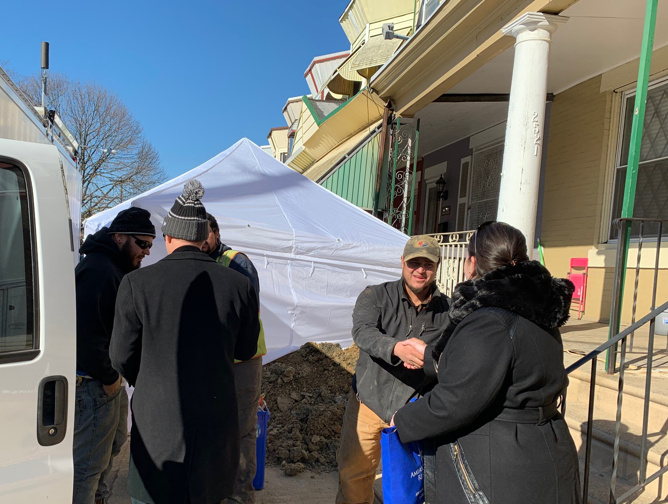
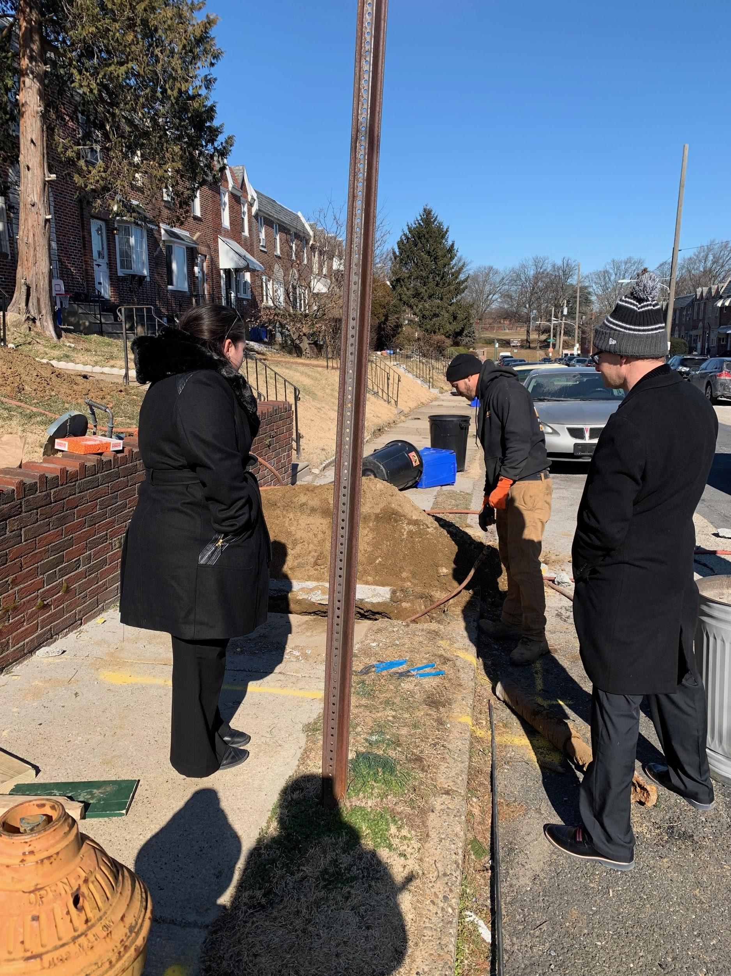
Water and Sewer Line Protection Program
90,000 customers
$16.3M+ in repair cost savings
73% of claims to date serviced by M/W/DBE contractors
7% of claims had a PWD NOD
Projected to save PWD >$140k annually

Slide 13
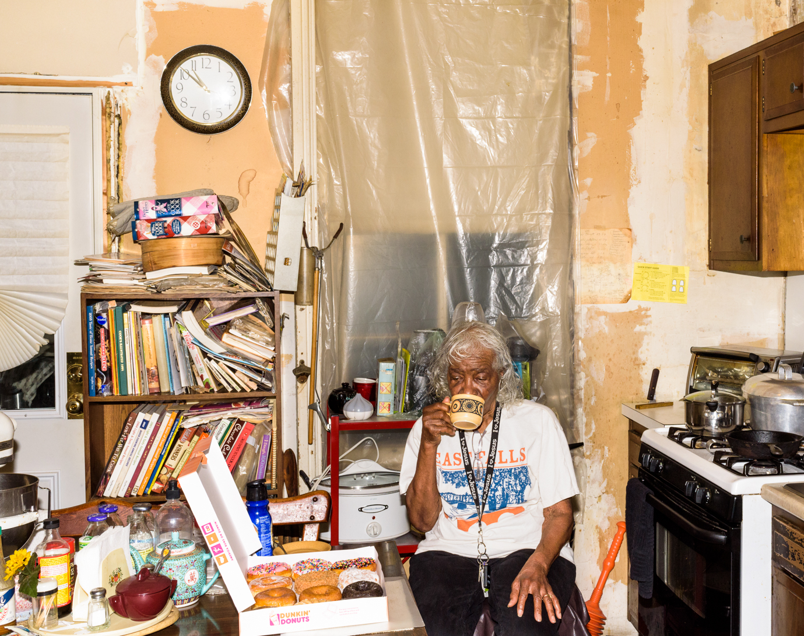
Built to Last Development
Program Roadmap will be completed by end of 2020
3-4 stakeholder workshops planned for Q3 and Q4 to define specific program roles and responsibilities
Planned paid focus groups with community members to refine program user experience and messaging
On track to execute a 50-home pilot in 2021 to demonstrate coordination of home improvement services, second pilot in 2022
Ongoing fundraising

Slide 14
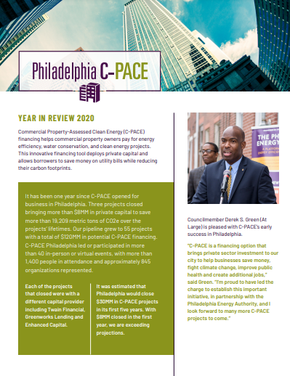
C-PACE Program Overview
Program Administration & Marketing
Produced C-PACE 2020 Year in Review
Presented at 7 virtual events reaching ~150 people since December meeting
Philly Capital Markets & CRE Finance event – March 10
Working with a consortium to expand PA C-PACE to include multifamily, stormwater and indoor air quality measures
Market News
First PA C-PACE project outside of Philadelphia closed in Montco: $10MM for a new hotel & firehouse restoration
C-PACE as “rescue financing” is increasing in popularity
2020 Year in Review

Slide 15
C-PACE Pipeline Outlook
58 projects in pipeline
Probability-weighted average value of pipeline is ~$23MM
Most common building types are commercial properties with multiple tenants and mixed-use residential/commercial buildings
Energy efficiency is still the most popular use of funds

Slide 16
Philadelphia Green Capital Corp.
Filed Articles of Incorporation with Pennsylvania Department of State on February 3, 2021
Preparing to file IRS 509(a)3 documents
Initial Directors have been identified
Anticipate hiring 1-2 staff members this year; job descriptions forthcoming
Starting fundraising outreach for $1.5MM in operating funds
Will be in addition to PEA funds set already aside for PGCC’s first three years of operation

Slide 17
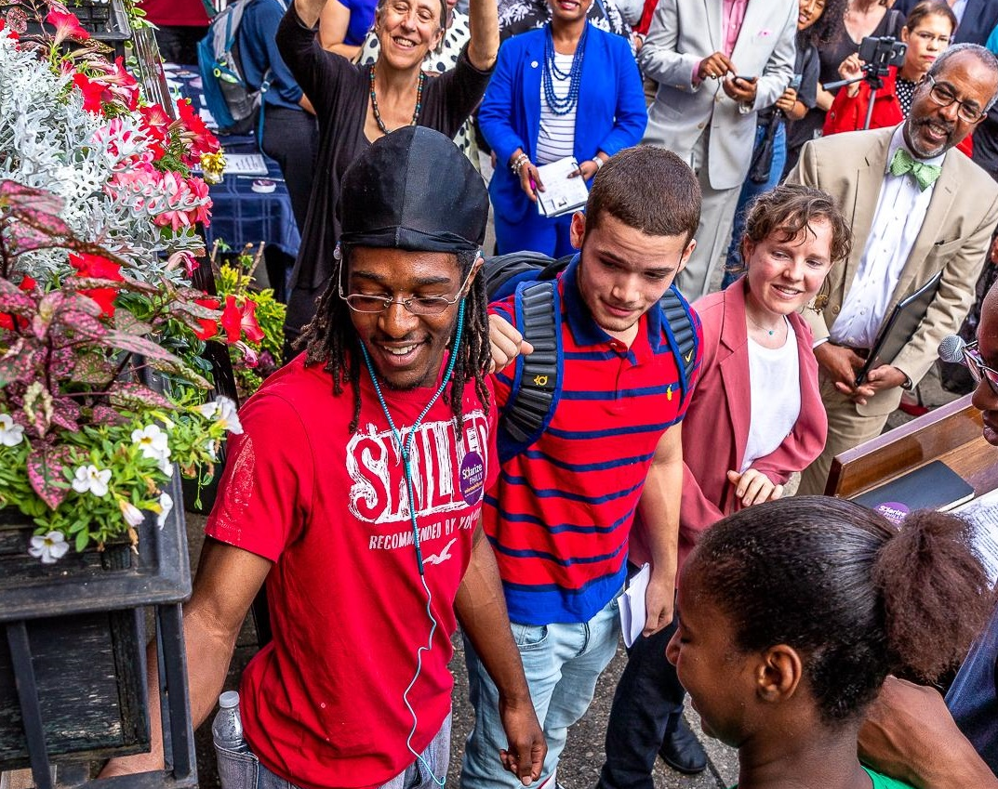
Contact
Emily Schapira
Executive Director
eschapira@philaenergy.org
215-686-4483
philaenergy.org
solarizephilly.org
philadelphiaCPACE.org
awrusa.com/Philadelphia

